Slide 1

July 25 Videoconference Call
Alan Flury
Scheller College of Business

Slide 2
MGT8803 Business Fundamentals for Analytics Video Conference Call #12 Agenda
Wrap-up on External Analysis
Internal Analysis
Formulating Strategy
Business Unit
Corporate Level

Slide 3
MGT8803 Business Fundamentals for Analytics Video Conference Call #12 External Analysis Wrap-up
Product Diversification and Differentiation
Deli and eat in facilities
Fresh pre-packed food products and “hot kitchens”
Branded Bakeries, Delis, Coffee Shops
Non-Food Services: Retail Banks, Pharmacies, Florists, Gasoline
General Merchandise
Branded Organic Foods
Private Label Products
Learnings for the Porter Analysis
Buyers are Price Sensitive
Low customer switching costs
The CP Branded products are undifferentiated across chains
Lots of Substitutes and non-industry alternatives
Shrinking Market Size (pressure from top and bottom)
Barriers to Entry (Partially) Coming Down
Loyalty Programs – From “Green Stamps” to Lower Prices
Advanced Analytics – From Stocking Strategies to Customer Promotions
Web-based shopping/pick-up and delivery

Slide 4
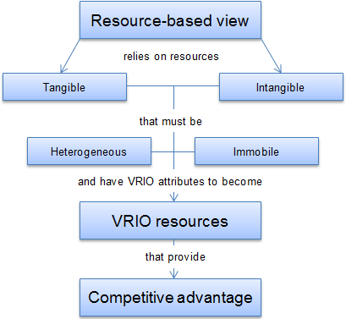
MGT8803 Business Fundamentals for Analytics Video Conference Call #12 Internal Analysis
Core Competencies
Capabilities
The Firm’s Resources
Tangible
Capital
Land
Buildings
Plant
Equipment
Technology
Supplies
Intangible/Human
People/Knowledge
Culture
Brand Equity/Reputation
Partnerships
Intellectual Property
Organizational Resources (effective strategic
planning, strong culture of innovation,
unique location)

Slide 5
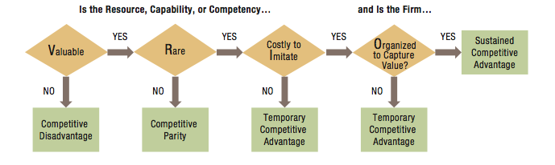
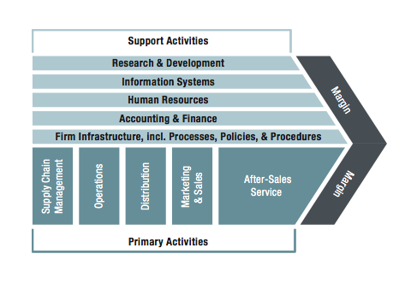
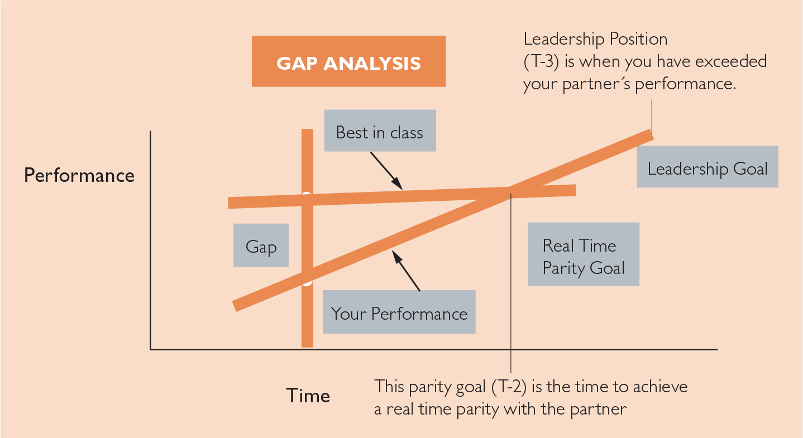
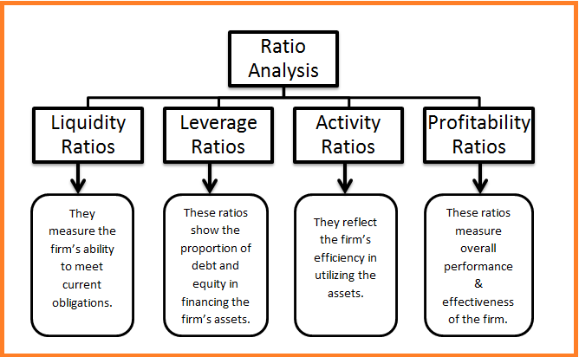
MGT8803Business Fundamentals for Analytics Video Conference Call #12 Internal Analysis
VRIO
Value Chain Analysis
Benchmarking
Financial Analysis (key ratio analysis)

Slide 6
MGT8803 Business Fundamentals for Analytics Video Conference Call #12 Firm Structure
Corporate
CEO/
President
EVP
Infant Apparel
EVP
Infant Toys
CTO
(Technology)
CFO
(Finance)
SVP
HR
Marketing and Sales
Marketing and Sales
Infant Apparel and Infant Toys are 2 SBUs that Share Common
Services: Technology, Finance, and HR
Production
Production
Design
R&D
SBU

Slide 7
MGT8803 Business Fundamentals for Analytics Video Conference Call #12 Business Strategy and Business Models
Corporate Strategies – Key Issues
Markets (What markets will the firm serve? Firm Scope)
Alliances, mergers, acquisitions, divestitures
Capital Allocation across Business Units
Set SBU “grand strategies” and targets
Establish shared services

Slide 8
MGT8803 Business Fundamentals for Analytics Video Conference Call #12 Growth Strategy Discussion
Concentration: growing by focusing on the firms core business – its primary business – and increasing the number of products or services offered or the number of markets served
Diversification: growing by moving into a different industry. Strategy here is typically determined at the corporate level
Vertical Integration: growing by gaining control over either the firms inputs (suppliers) or outputs (distributors/retailers). Typically growth through acquisition
Horizontal Integration: growing by combining with a competitor. May be an acquisition or merger
SBU
Corporate
Corporate
Corporate/SBU

Slide 9
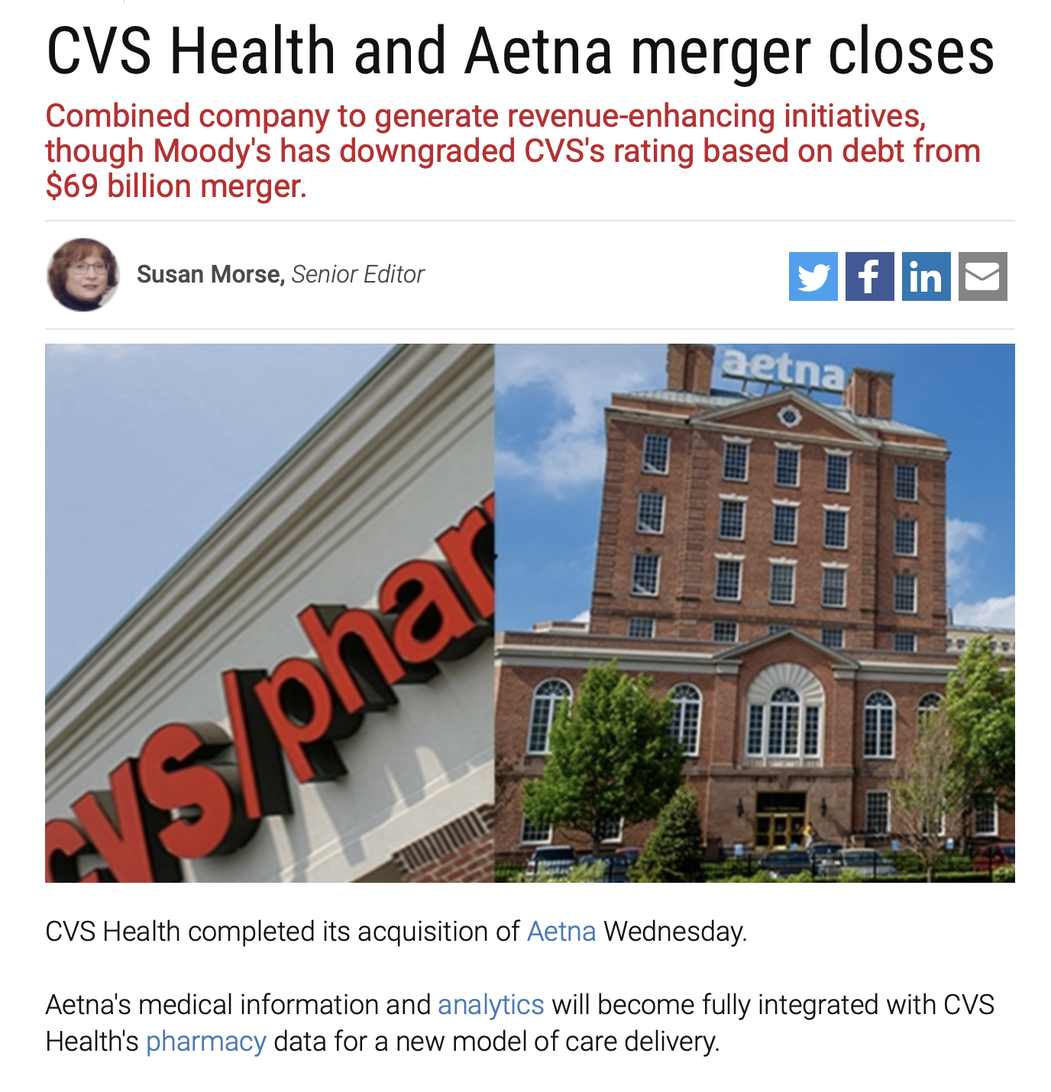
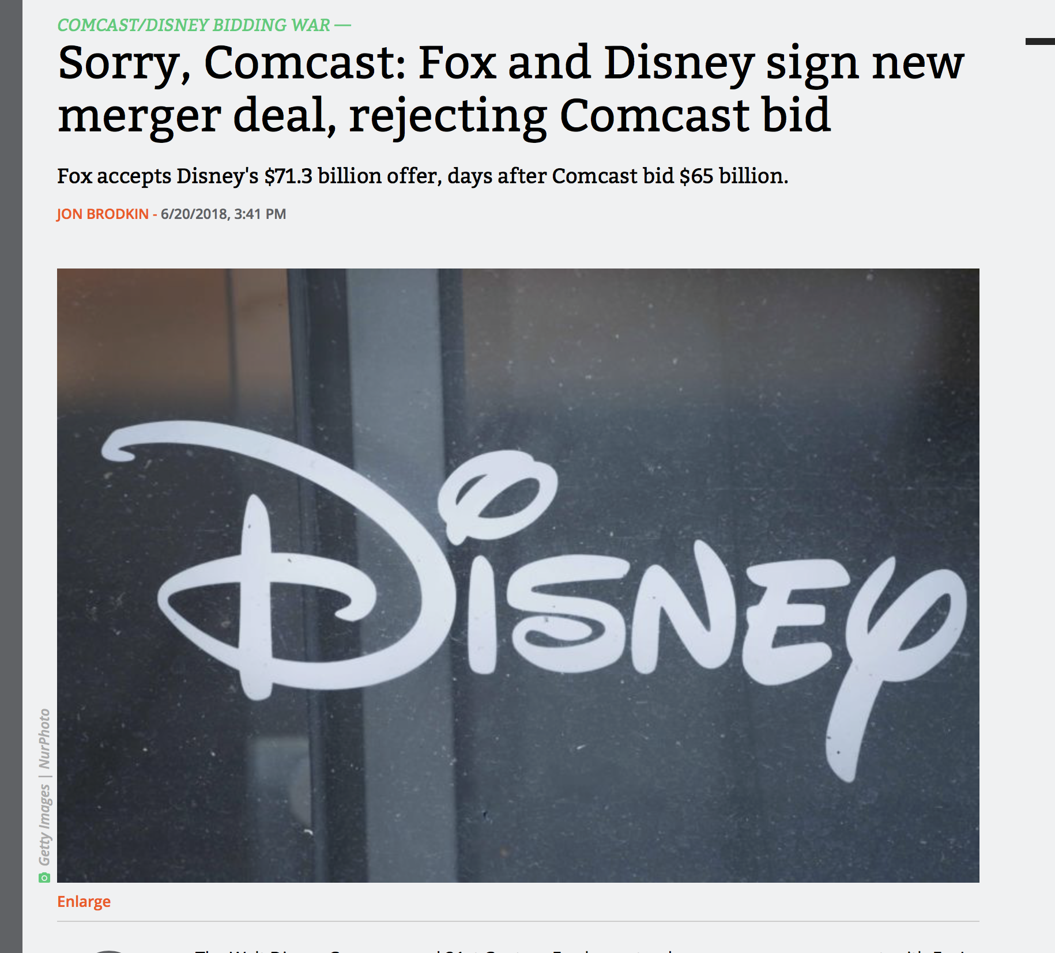
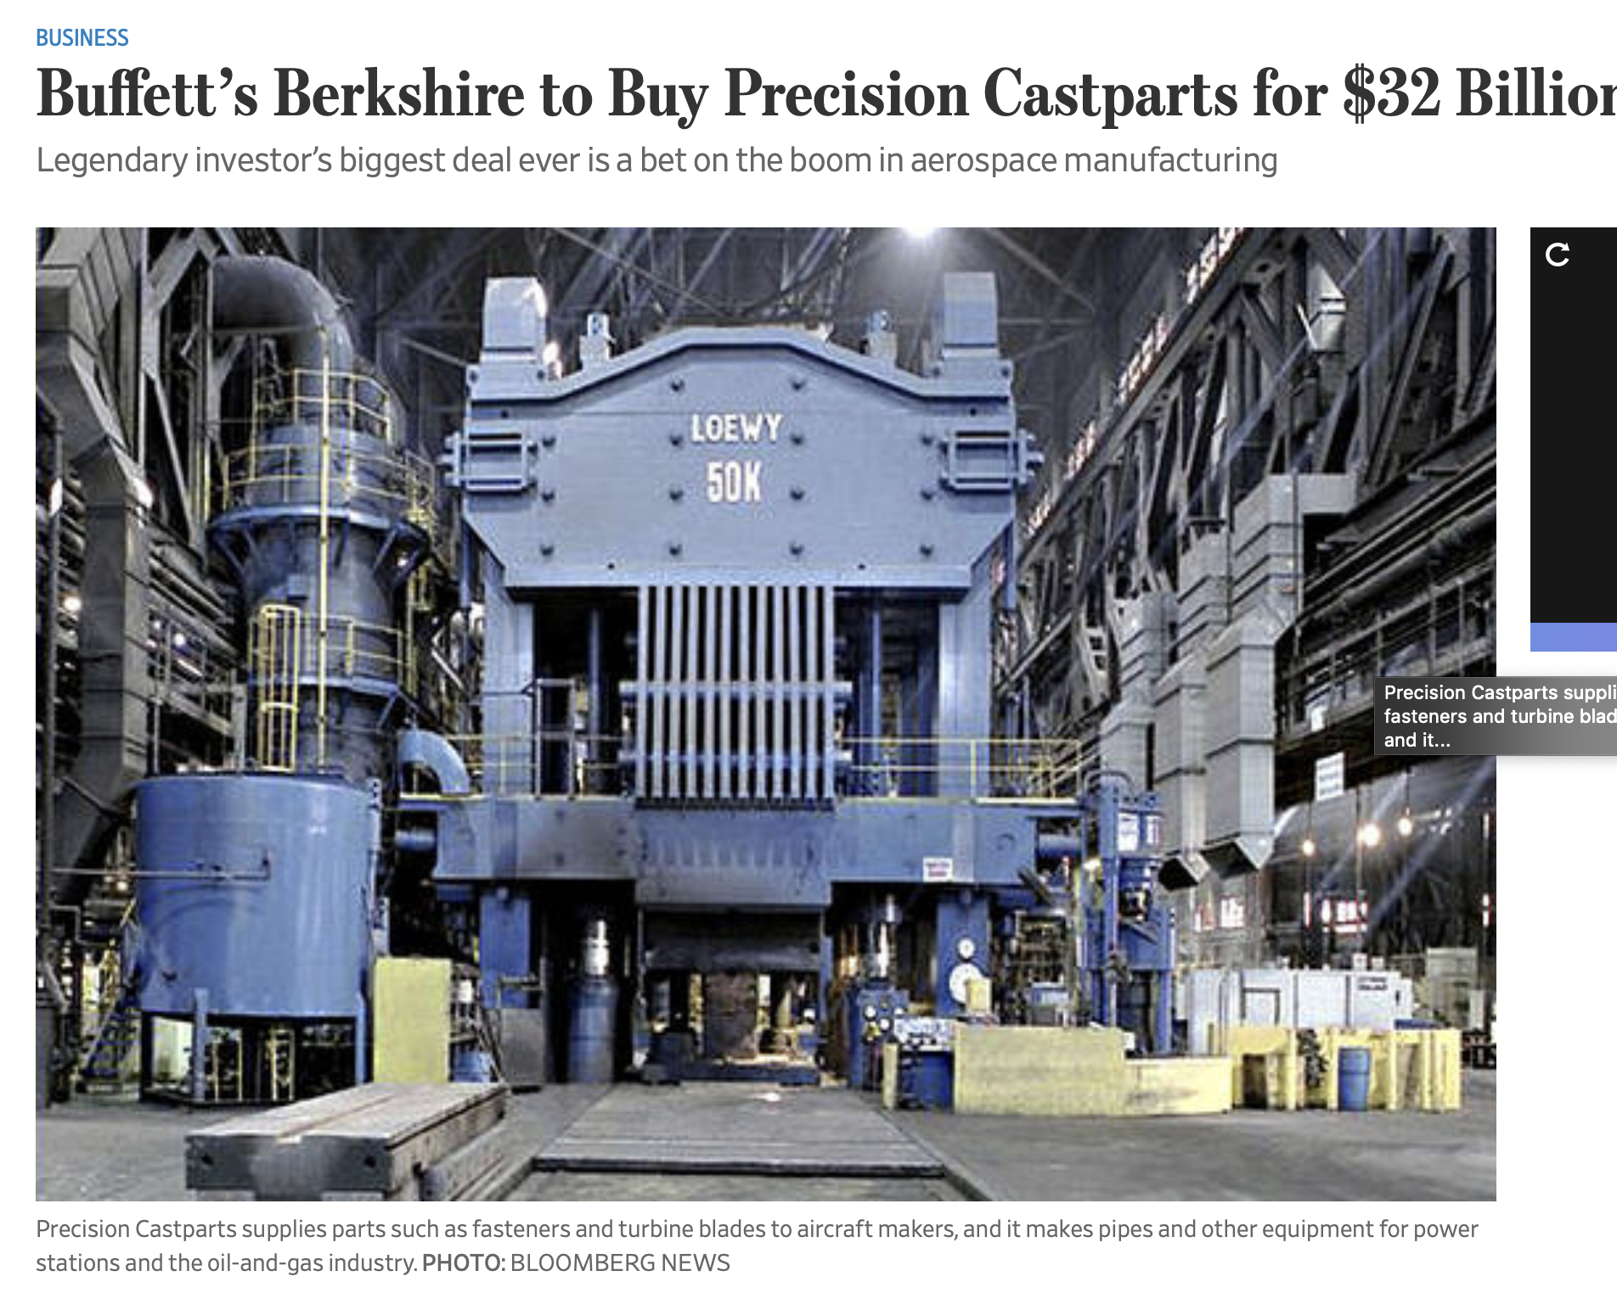
MGT8803 Business Fundamentals for Analytics Video Conference Call #12 Business Strategy and Business Models
Corporate Strategies
The purchase is Berkshire’s largest, and accelerates its transformation from a company largely dependent on insurance businesses into one resembling the broader U.S. economy, including a railroad, several industrial companies, consumer goods businesses, utilities and car dealerships
Vertical Integration Horizontal Integration Diversification
Aetna is a blockbuster in vertical integration — it will combine one of the nation’s biggest health insurance companies with drug stores, clinics and prescription-distribution operations. As a result, CVS-Aetna will control more of the care delivery spectrum, enhancing its ability to improve outcomes and reduce health care costs.
This acquisition is about the Murdoch family cashing out and Disney trying to future-proof its empire. The alliance will result in fewer choices and higher prices (for the consumer) since it will consolidate ownership of important content and distribution properties under one roof distribution
Notes:
CVS-Aetna is a blockbuster in vertical integration — it will combine one of the nation’s biggest health insurance companies with drug stores, clinics and prescription-distribution operations. As a result, CVS-Aetna will control more of the care delivery spectrum, enhancing its ability to improve outcomes and reduce health care costs. We expect the perceived benefits of the CVS-Aetna merger to encourage other organizations seeking integration to consider consolidating with pharmacy entities.

Slide 10
MGT8803 Business Fundamentals for Analytics Video Conference Call #12 Business Strategy and Business Models
Corporate Strategies
Why
Reduces Costs
Secures Supply Sources
More control over the value chain
Increased differentiation
Reduces Competition
Fills in Product/Market Gaps
Increased product differentiation
Increased Economies of Scale
Economies of Scale and Scope
Better Leverage Managerial Skills
Cross Subsidize Products
Spread Financial Risks Over Different Markets
Why Not
Increased management complexity
Increased risks
Possibly higher costs and poorer quality
Integration failure
Increased management complexity
Increased coordination and influence costs
Impossibly stretched management team
Vertical Integration
Horizontal Integration
Diversification

Slide 11
MGT8803 Business Fundamentals for Analytics Video Conference Call #12 Growth Strategy Discussion
Concentration: growing by focusing on the firms core business – its primary business – and increasing the number of products or services offered or the number of markets served
Diversification: growing by moving into a different industry. Strategy here is typically determined at the corporate level
Vertical Integration: growing by gaining control over either the firms inputs (suppliers) or outputs (distributors/retailers). Typically growth through acquisition
Horizontal Integration: growing by combining with a competitor. May be an acquisition or merger
SBU
Corporate
Corporate
Corporate/SBU

Slide 12
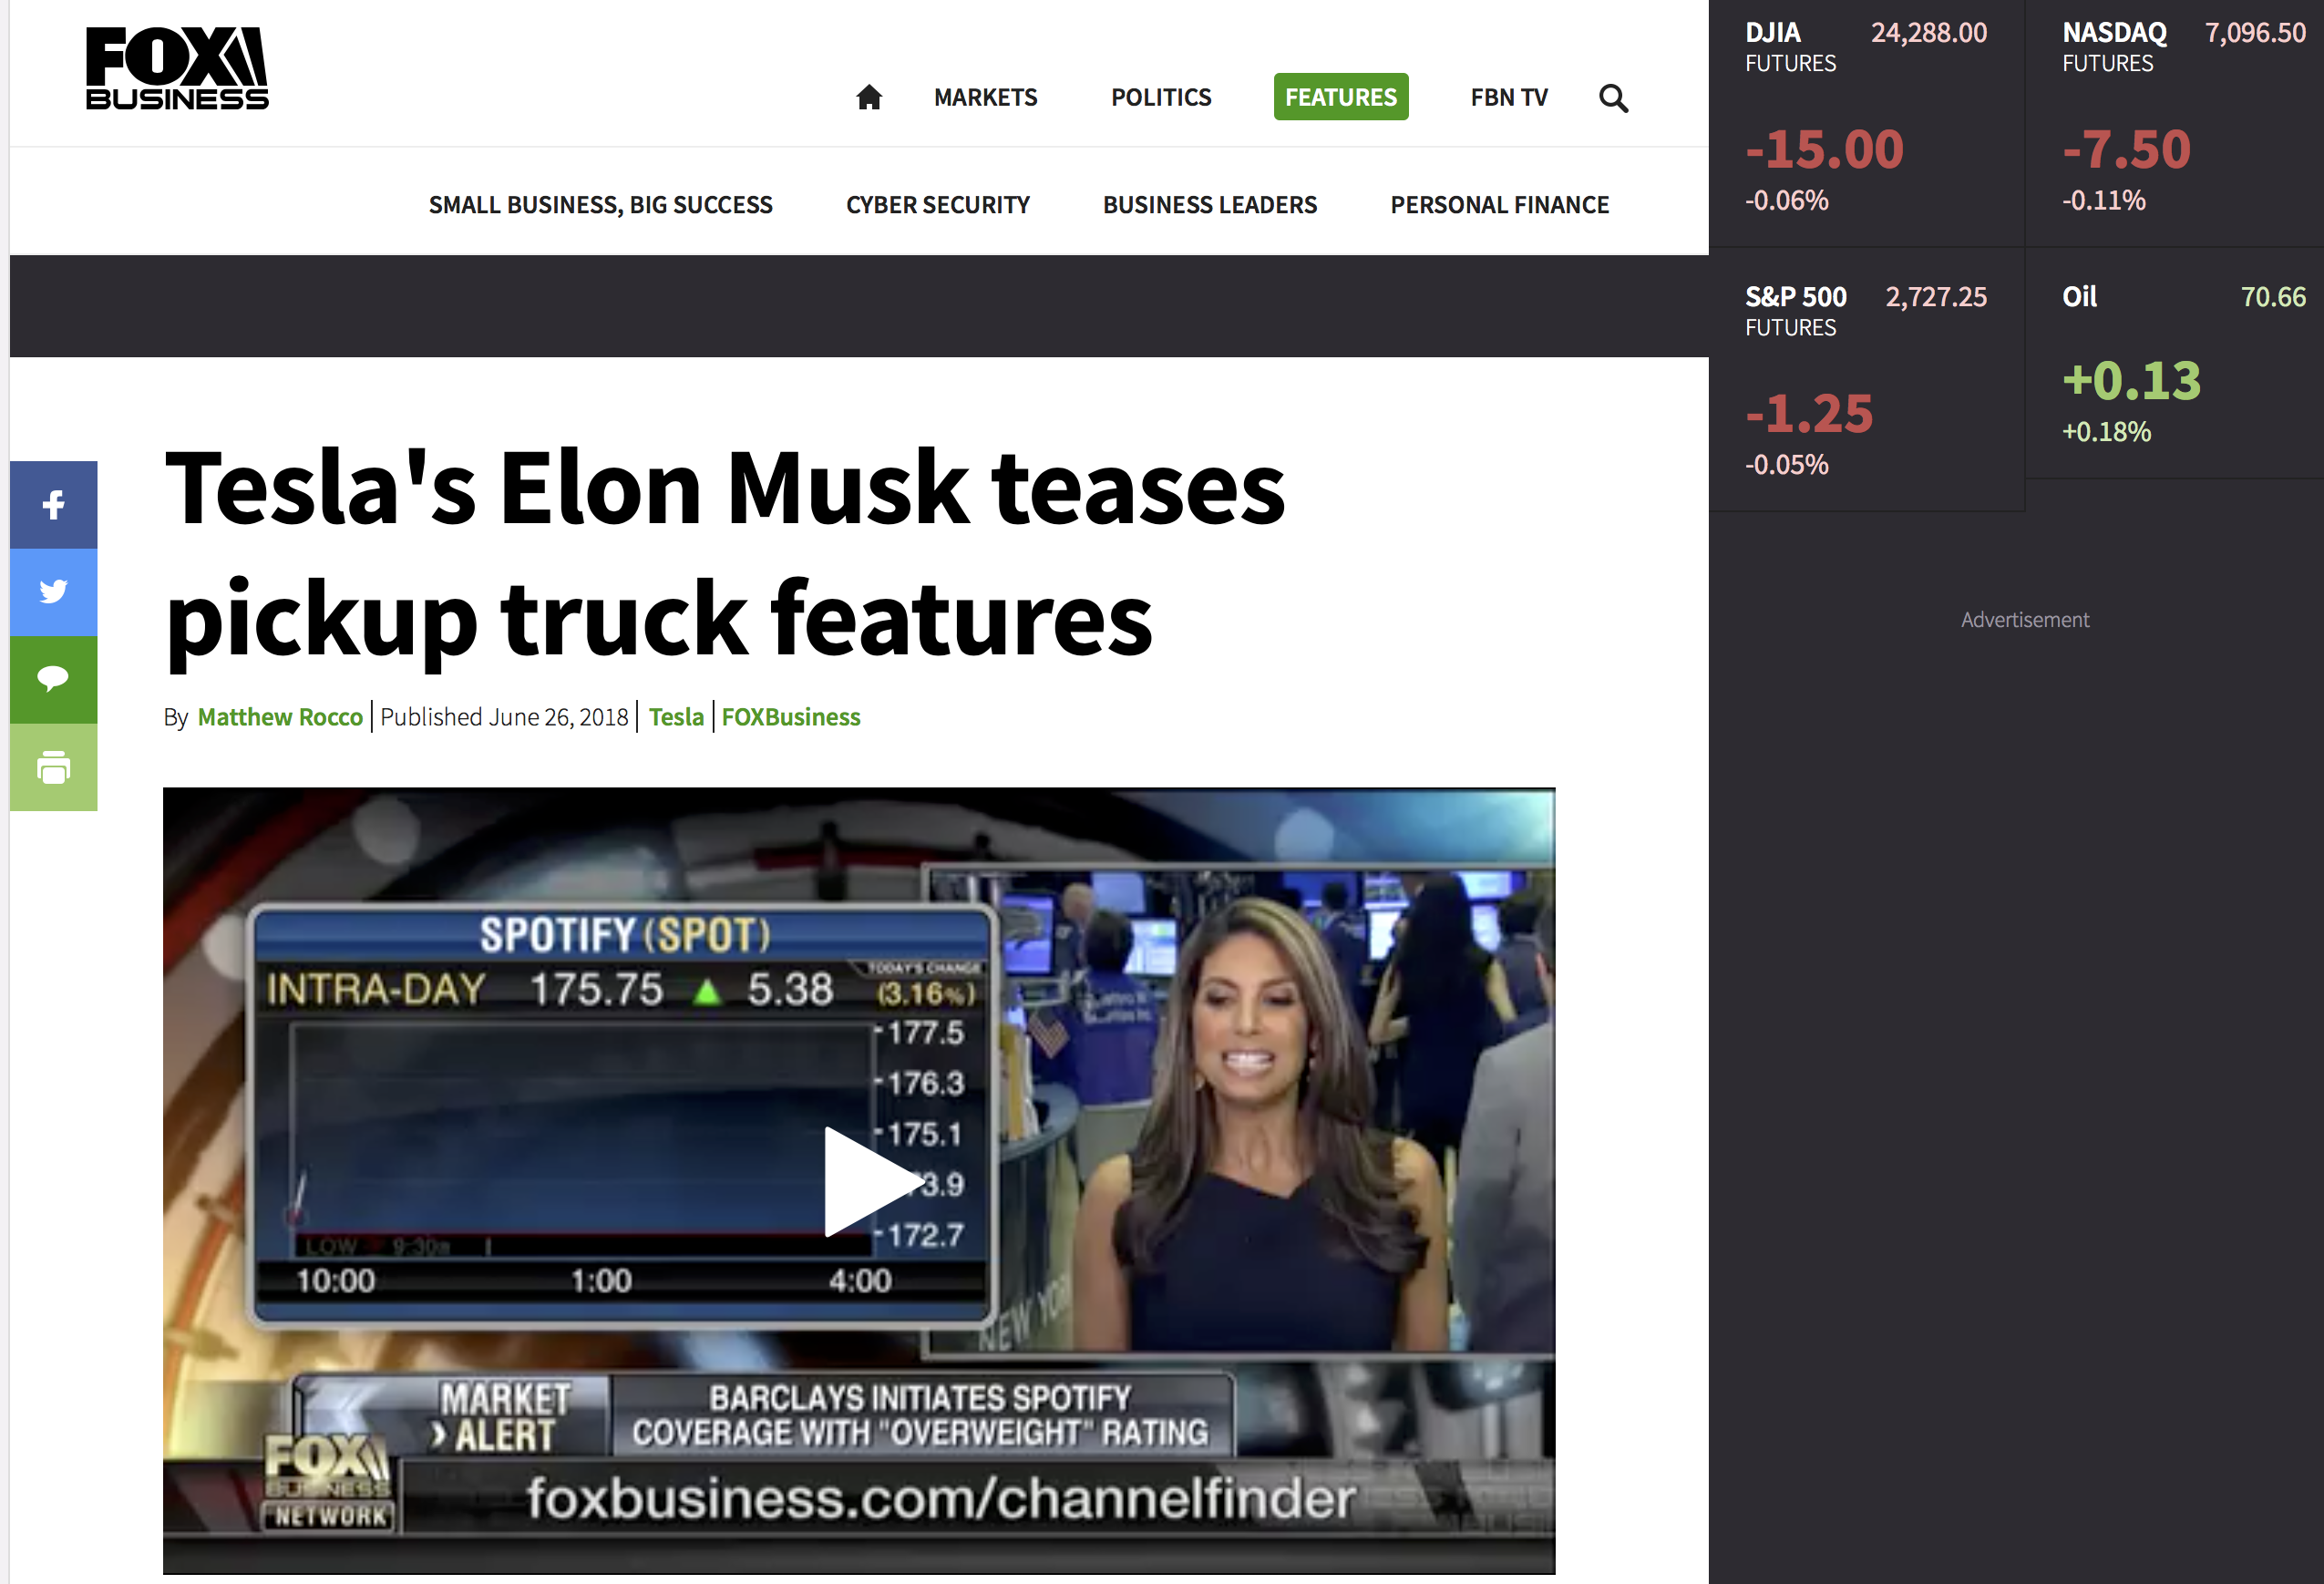
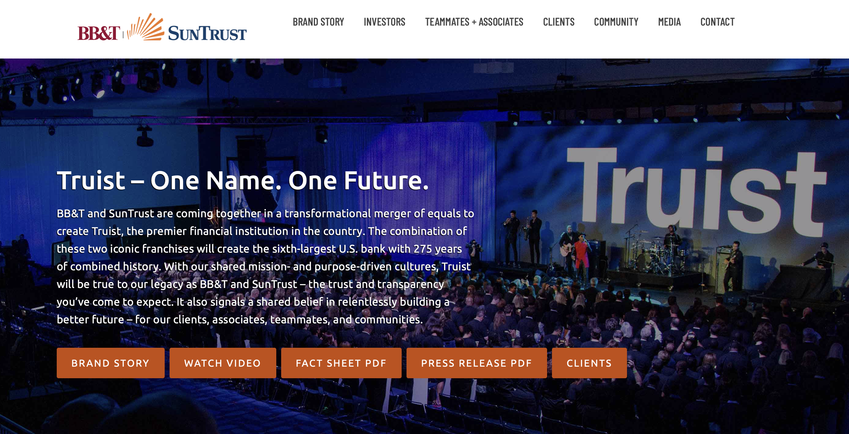
MGT8803 Business Fundamentals for Analytics Video Conference Call #12 Business Strategy and Business Models
Business Unit Strategies
Creating and Sustaining a Competitive Advantage
Generic Strategies: Cost Leadership, Differentiation, and Focus. Combination strategies
Grand Strategies: Growth, Stability, and Renewal

Slide 13
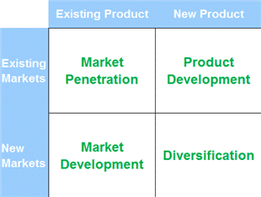
MGT8803 Business Fundamentals for Analytics Video Conference Call #12 Ansoff Matrix (Concentration Strategies)
New Product Lines (related to the core)
Product Line Extensions
Penetration Pricing
Bundling
Aggressive Advertising
Sustaining Product
Improvements
Horizontal integration
Can be either organic (innovation) or
inorganic (acquisition) initiatives
Globalization
Targeting New Segments
Business Alliances with Complementary Firms

Slide 14
MGT8803 Business Fundamentals for Analytics Video Conference Call #12 Business Strategy and Business Models Business Unit Strategies
Business level strategy is driven by a firms strategic positioning – cost, differentiation, focus, or combination -- when competing in a single industry or product market
In a differentiation strategy the focus is on value drivers while controlling costs. In a cost leadership strategy the focus is on achieving the lowest possible costs while maintaining acceptable value
A successful combination strategy requires that the tradeoffs between differentiation and low costs be reconciled. One approach is through Value Innovation.
Unsuccessful combination strategies can create significant competitive challenges for firms that find themselves stuck in the middle

Slide 15
MGT8803 Business Fundamentals for Analytics Video Conference Call #12 Business Strategy Blue Oceans and Value Innovation
Eliminate: Factors What the industry or customer takes for granted. Factors that the Industry has Long Completed On
Reduce: Specific Factors Below Industry Standards to restructure Costs
Raise: Specific Factors Above Industry Standards to Provide Enhanced value to the Customer
Create: Factors that the industry never offered before to customers and non-customers
Cost
Value
Innovation
Total Perceived
Customer Benefits

